Slide 1



Supervised Learning
Predicting The Asking Price for:
Used Car Vehicle Listings
on Craigslist.org
by
Robert Harris

Slide 2

So, it’s time to sell your car
You’ve decided to list it on Craigslist
But, how for how much ???
Time to do some research

Slide 3
You scour the current listings
Low miles, garage kept, granny driven, …
A4/S4, A5/S5, A6/S6, A7/S7/RS7, …
1 car, 2 car, red car, blue car, …
Information Overload!!!

Slide 4
Where to turn?
Don’t worry – we’ve got you covered
Predictive Modeling – Supervised Learning
Hal the supercomputer has your back

Slide 5

Task - Predict Asking Price
Develop a machine learning algorithm
Gather car’s features
Input those features
Shake them, not stirred
Voilà: Your Price is _____

Slide 6

Market: California

Slide 7
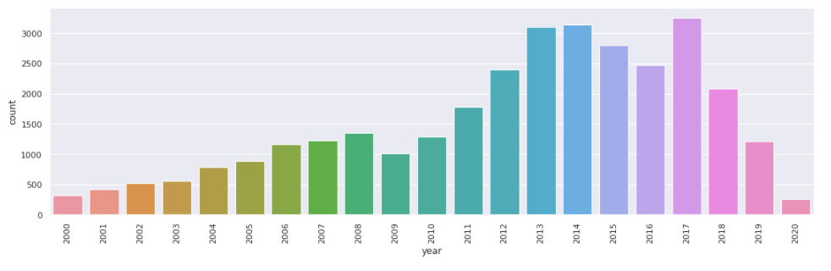
Supply per Model Year:

Slide 8
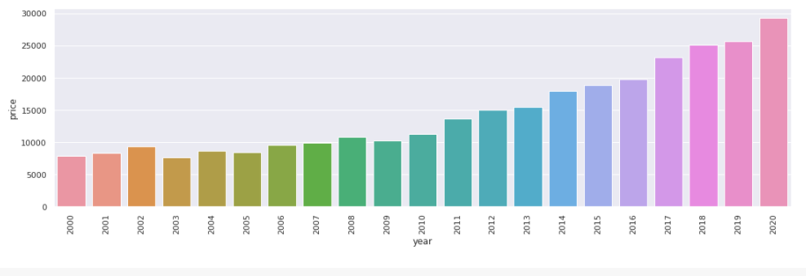
Average Price per Year:

Slide 9
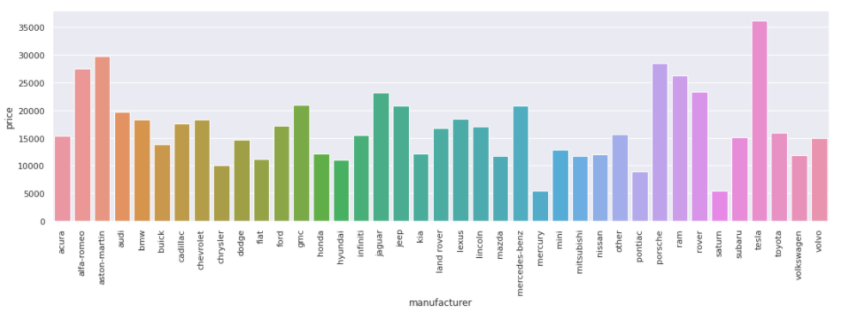
Average Price per Make:

Slide 10

Identify Key Features & Issues:
Manufacturer: Quantify valuation?
Model: Quantify valuation?
Year: No year listed?
Miles: Missing information?
Condition: new, like new, excellent, …
Color: white, black, …
Cylinders: 4, 6 , 8, …
Type: suv, sedan, coupe, …
Fuel Type: gas, hybrid, electric, …
Transmission: automatic, manual, …
Title: clean, salvage, parts only, …

Slide 11

Dataset Limitations:
File too large
Split into 46 files of 10K each
California (n = 45,634)
Different location - adjust model accordingly

Slide 12
‘Exploratory Data Analysis’
Clean dataset:
Only keep listings with a year and a price
Outliers in price and odometer eliminated
$2,808,349,000: Comes with a free haircut
10,000,000 miles: Firestone won’t even touch
Eliminated feature ‘size’ - 73% of data missing
Filter years from 2000 to present

Slide 13
Feature Engineering:
Manufacturer: average price per manufacturer
Model: average price per model per year
Year: eliminate listings with no year
Miles: rolling average of 50 nearest sorted odometer readings*
Condition: One – hot encoding
Color: “
Cylinders: “
Type: “
Fuel Type: gas vs non-gas
Transmission: automatic vs non-automatic
Title: clean vs non-clean (salvage, parts only, …)

Slide 14

Input Features –> Model:

Slide 15

The Testing Algorithms:
OLS – Linear Regression: Estimate unknown parameters
Lasso Regression: Reduces Overfitting
Ridge Regression: Eliminates unimportant features
Elastic Net Regression
Combines positives of both
Lasso and Ridge

Slide 16
Results:
Everyone of our Linear Regression Models predicted an accuracy score between 95.2 - 95.5% of listing an appropriate listing price as posted on Craigslist.org.
Furthermore, everyone of the algorithm results were verified with Cross-Validation scores reaching upwards of 96.2% accuracy.

Slide 17

Future Investigation:
Adjusting this model to incorporate sales price would be optimal.
The ability to predict the best listing price to maximize sales price would be an ideal direction to pursue.

Slide 18
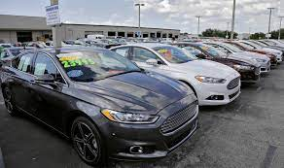
Happy Listing

